Slide 1

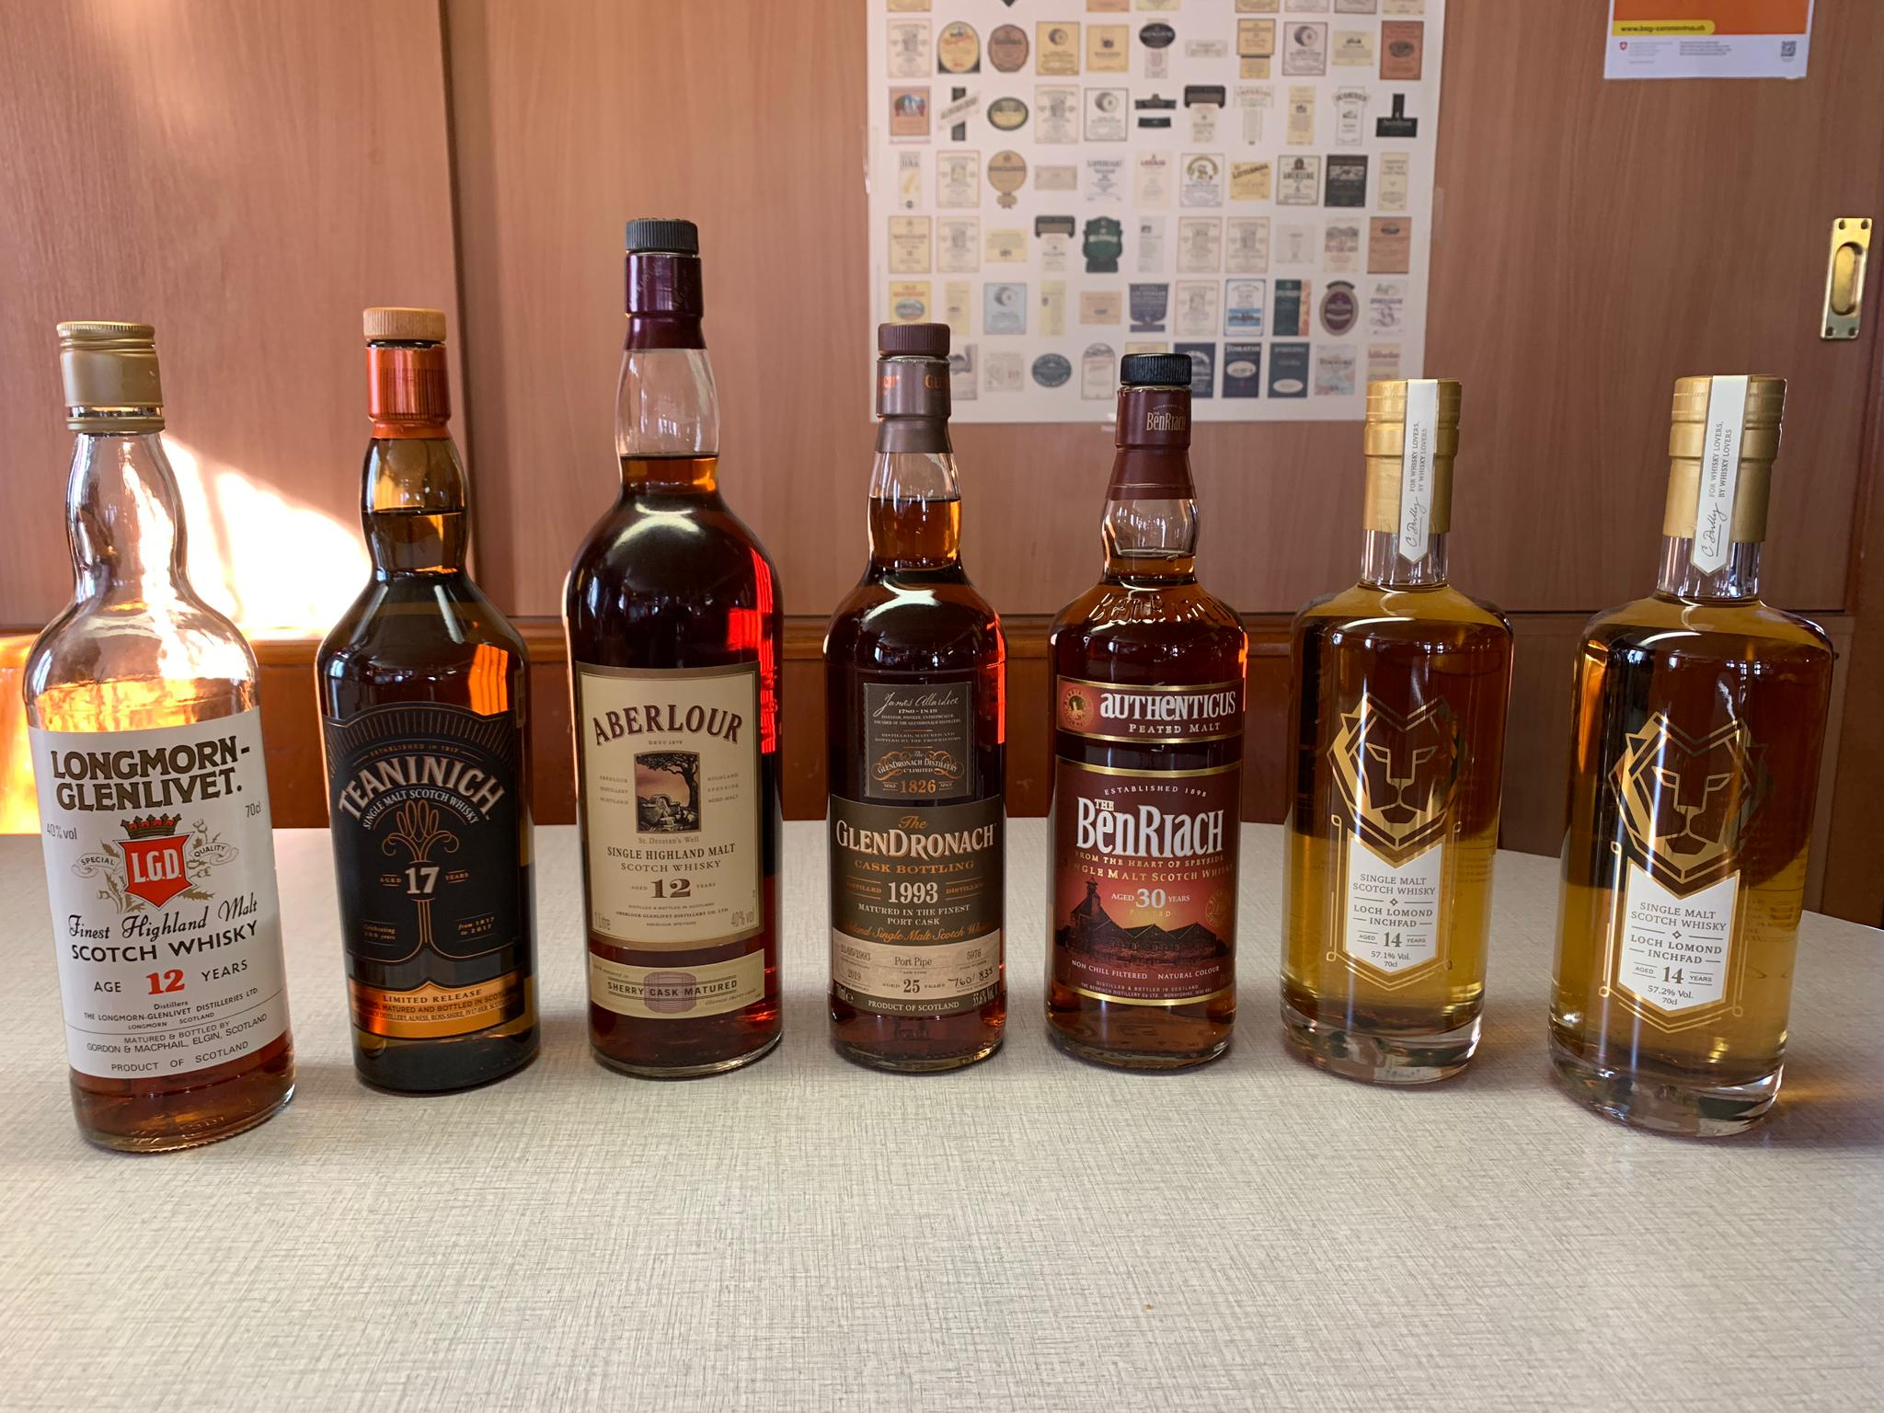
SEVENTEEN DRAMS
ONLINE TASTING 3. November 2020

Slide 2
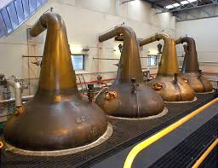
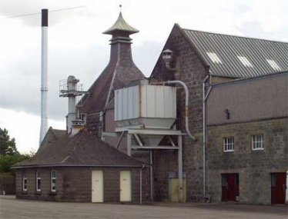

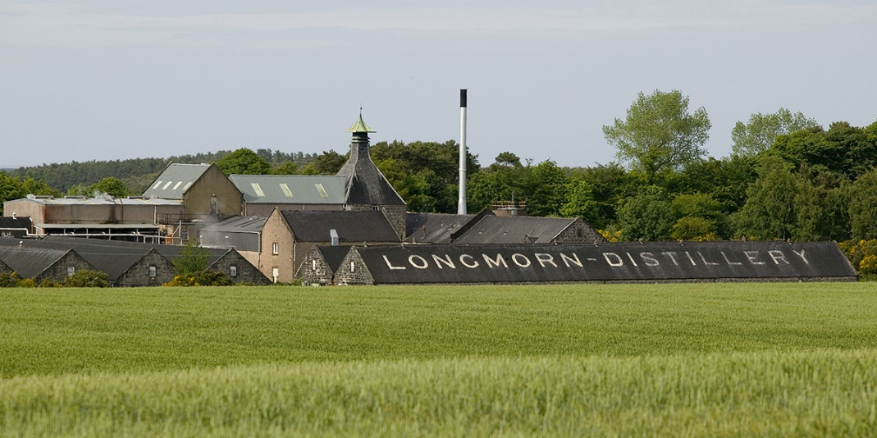
SEVENTEEN DRAMS
longmorn Estd. 1893
speyside

Slide 3
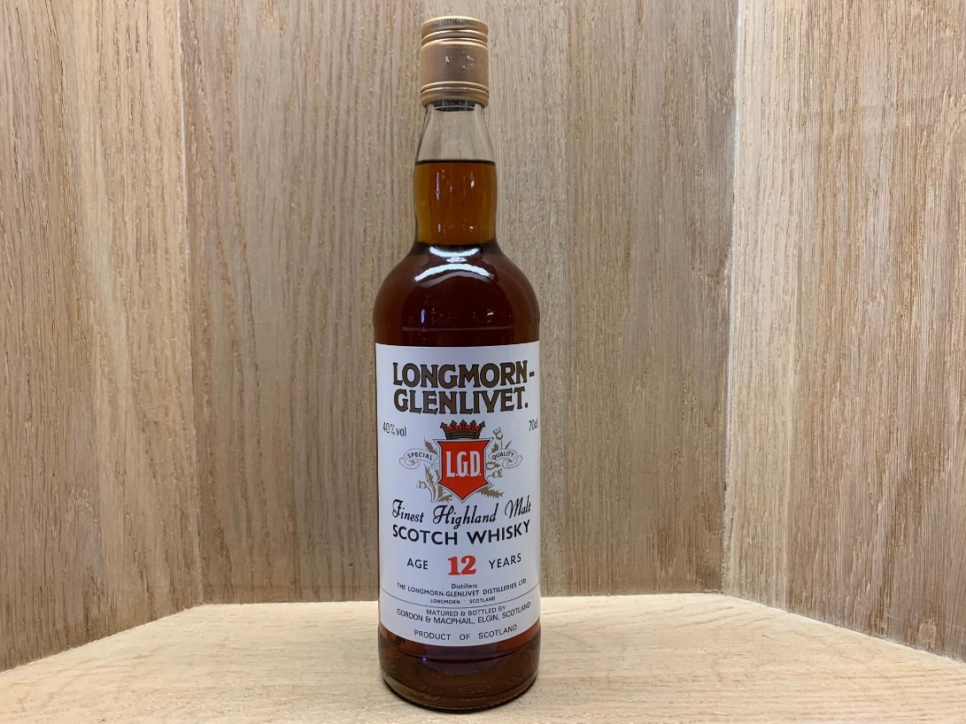
SEVENTEEN DRAMS
Gordon & macphails Longmorn-glenlivet 12y0 40%

Slide 4
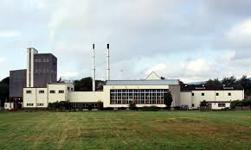
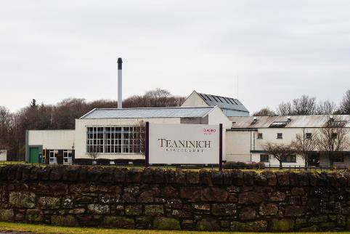
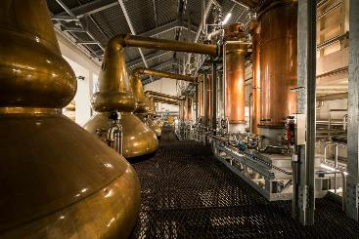
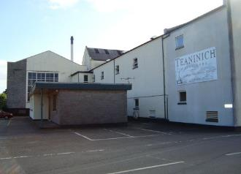
SEVENTEEN DRAMS
teaninich Estd. 1817
Northern highlands

Slide 5
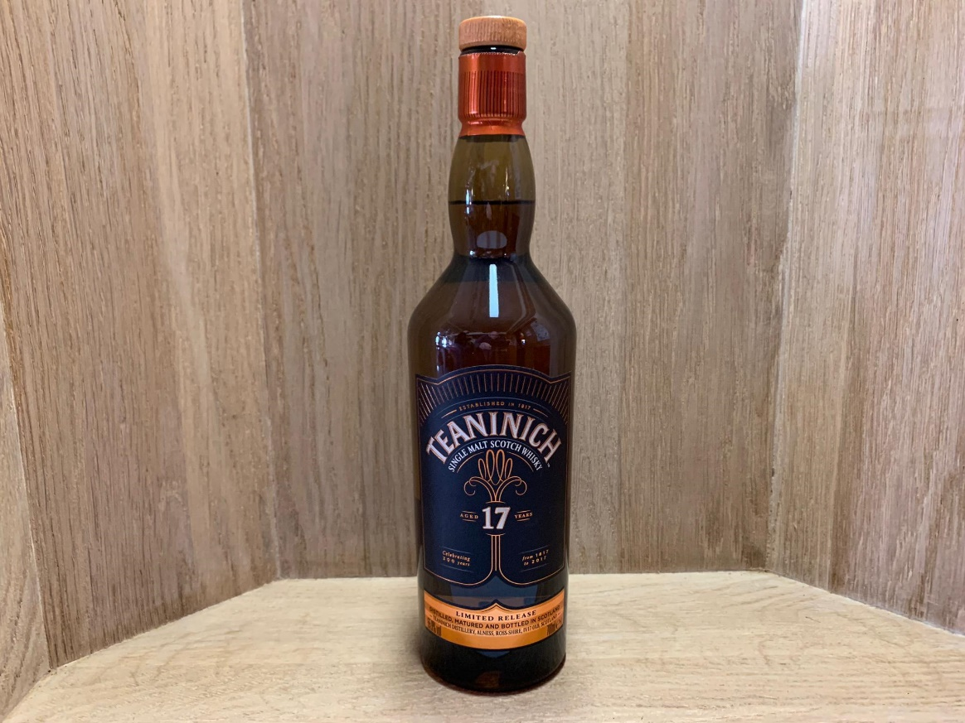
SEVENTEEN DRAMS
Teaninich 17y0 celebrate 200years Special release 2017 55.9%

Slide 6
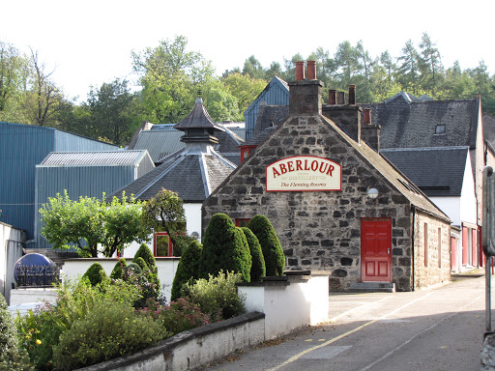
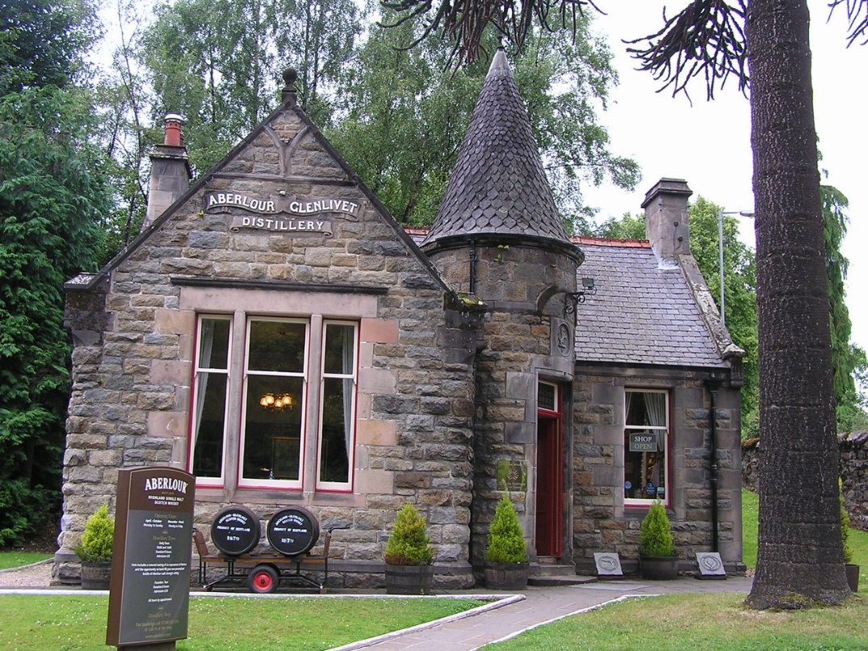
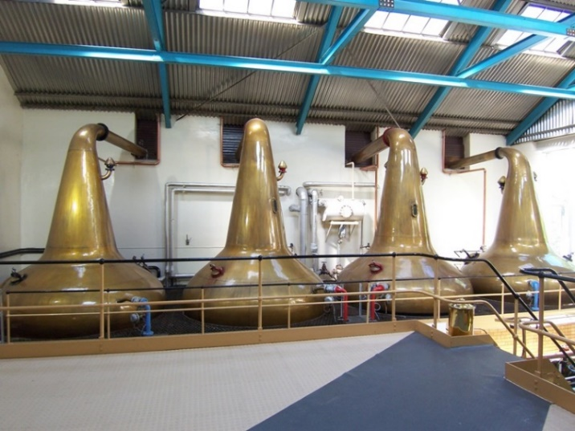
SEVENTEEN DRAMS
aberlour Estd. 1879
speyside

Slide 7
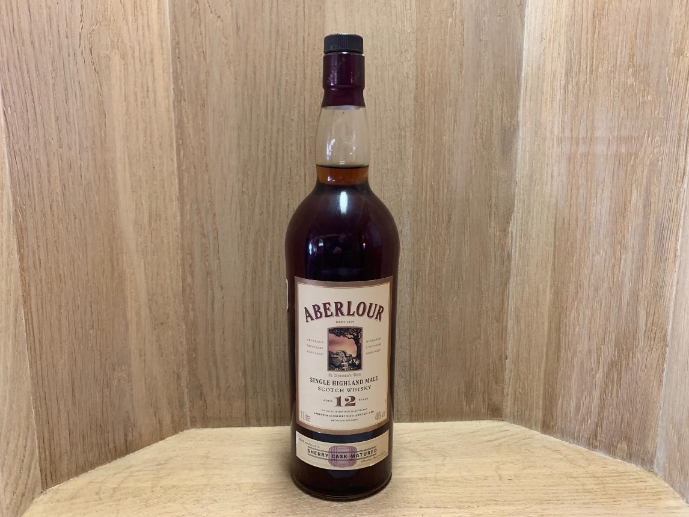
SEVENTEEN DRAMS
Aberlour 12 Yo duty paid sherry cask matured 40%

Slide 8
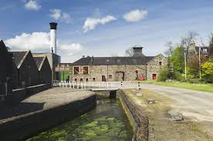
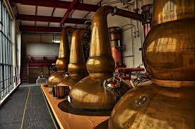
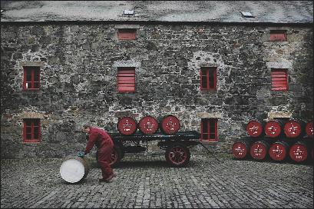
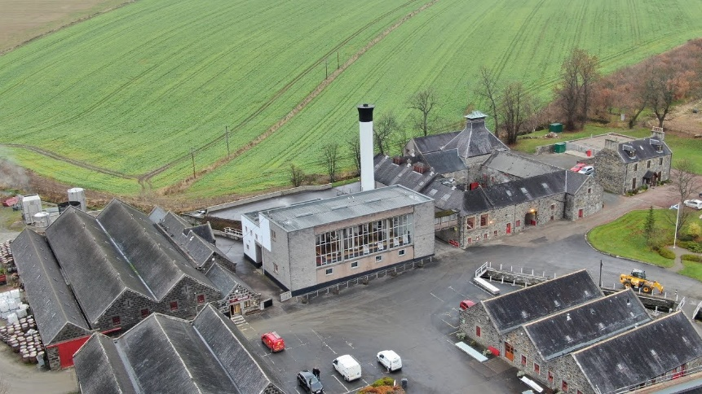
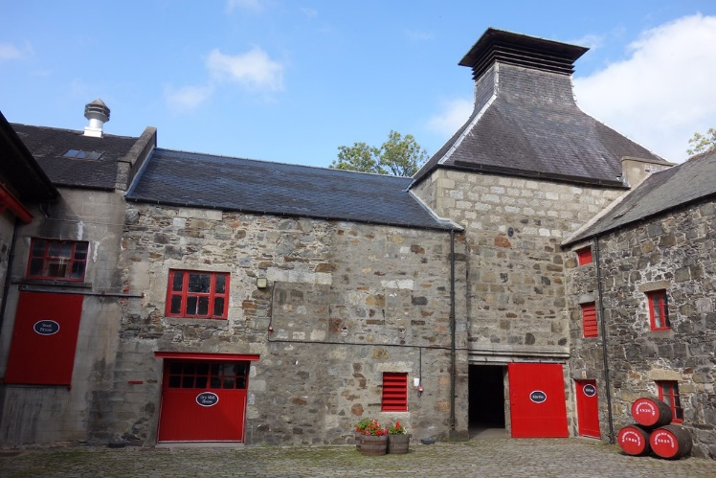
SEVENTEEN DRAMS
glendronach Estd. 1826
Eastern highlands

Slide 9
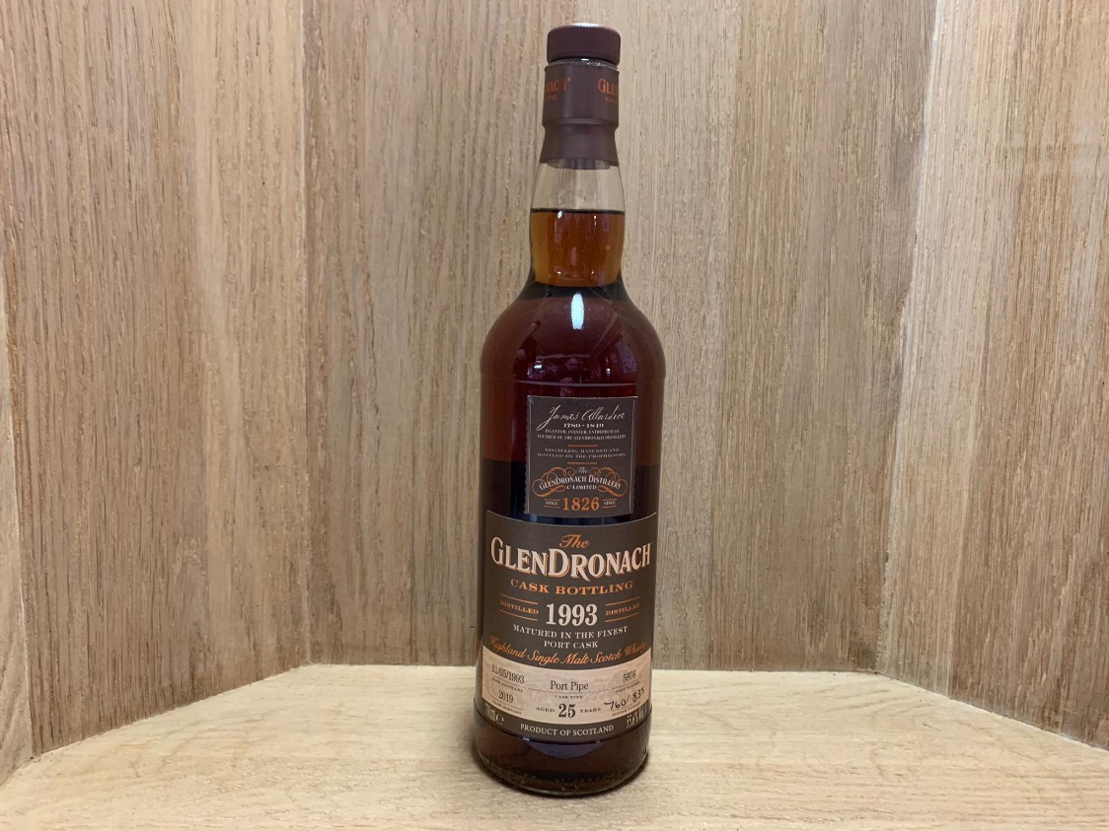
SEVENTEEN DRAMS
GLENDRONACH 25Y 1993/2019 port pipe
CASK NO. 5976 Bottle no. 760 of 835 55.6%

Slide 10
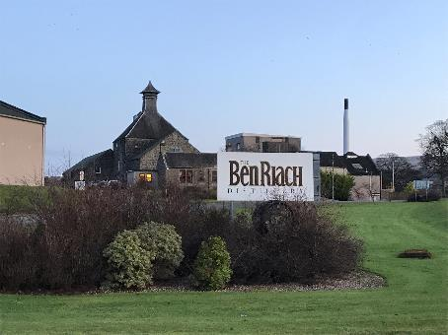
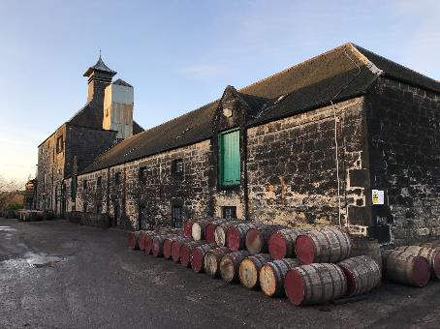
SEVENTEEN DRAMS
benriach Estd. 1897
Speyside

Slide 11
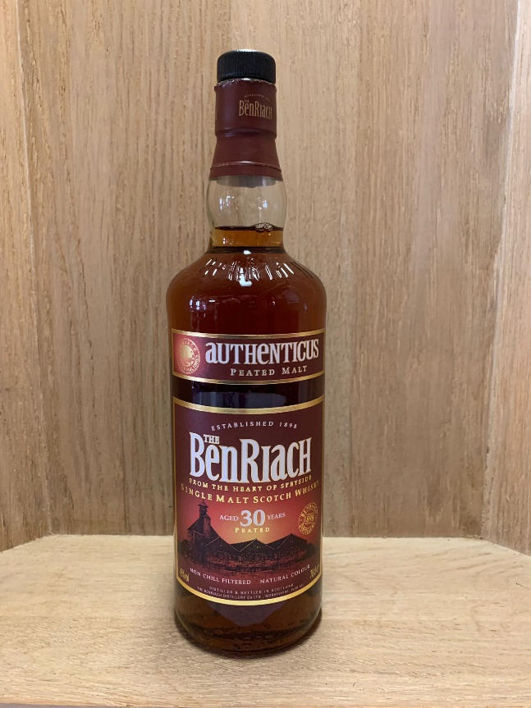
SEVENTEEN DRAMS
Benriach 30y0 «Authenticus peated Malt» 46%

Slide 12
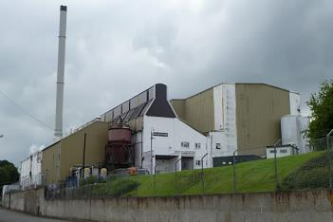
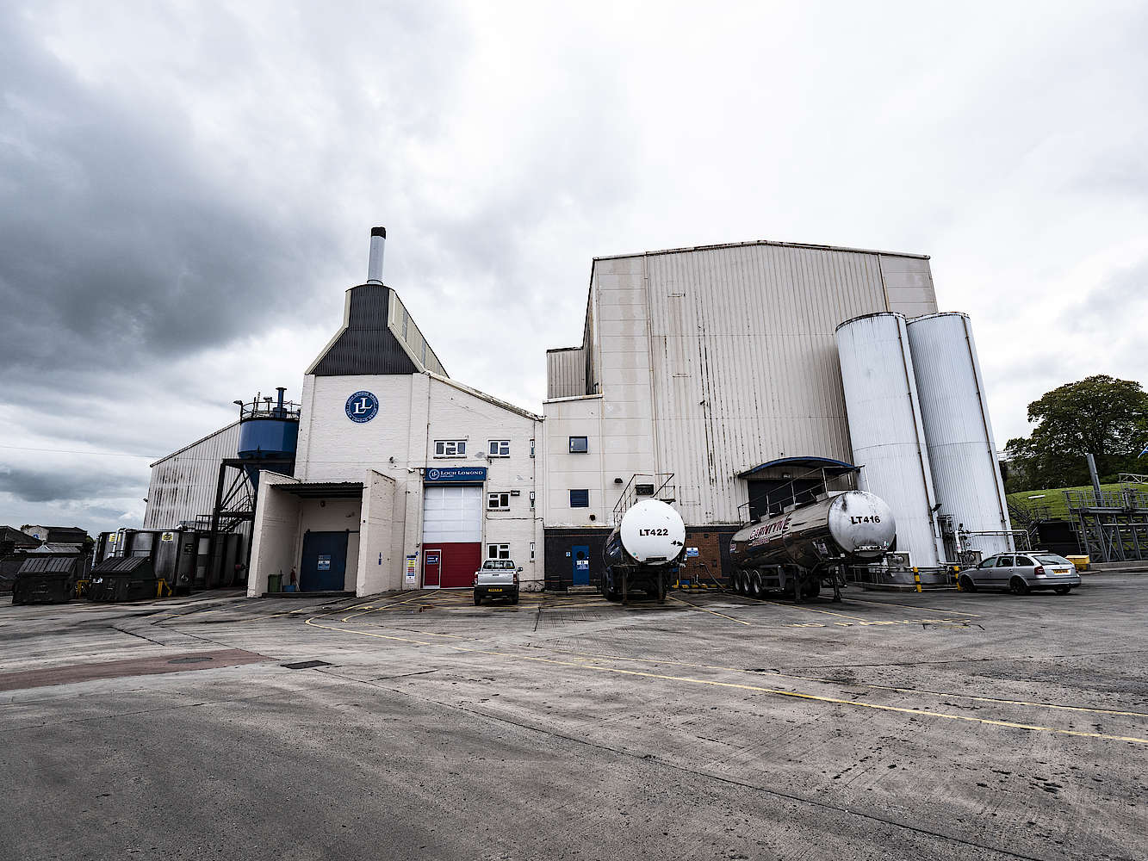
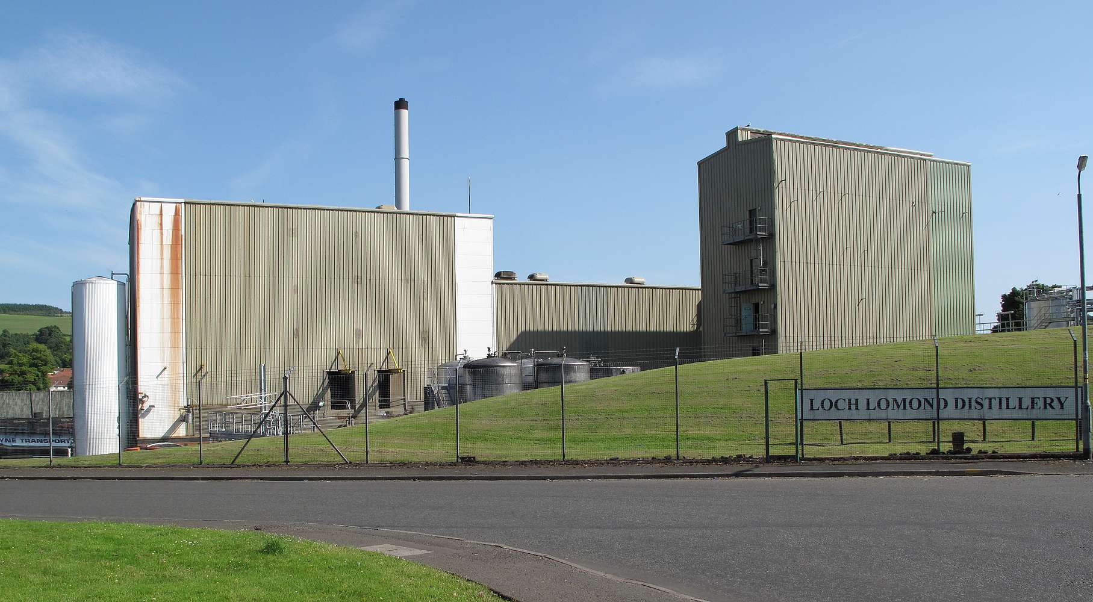
SEVENTEEN DRAMS
Loch lomond Estd. 1965
Western highlands

Slide 13
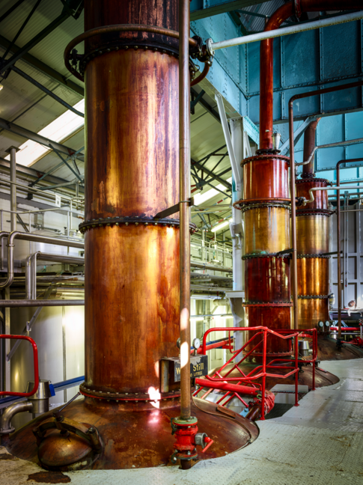
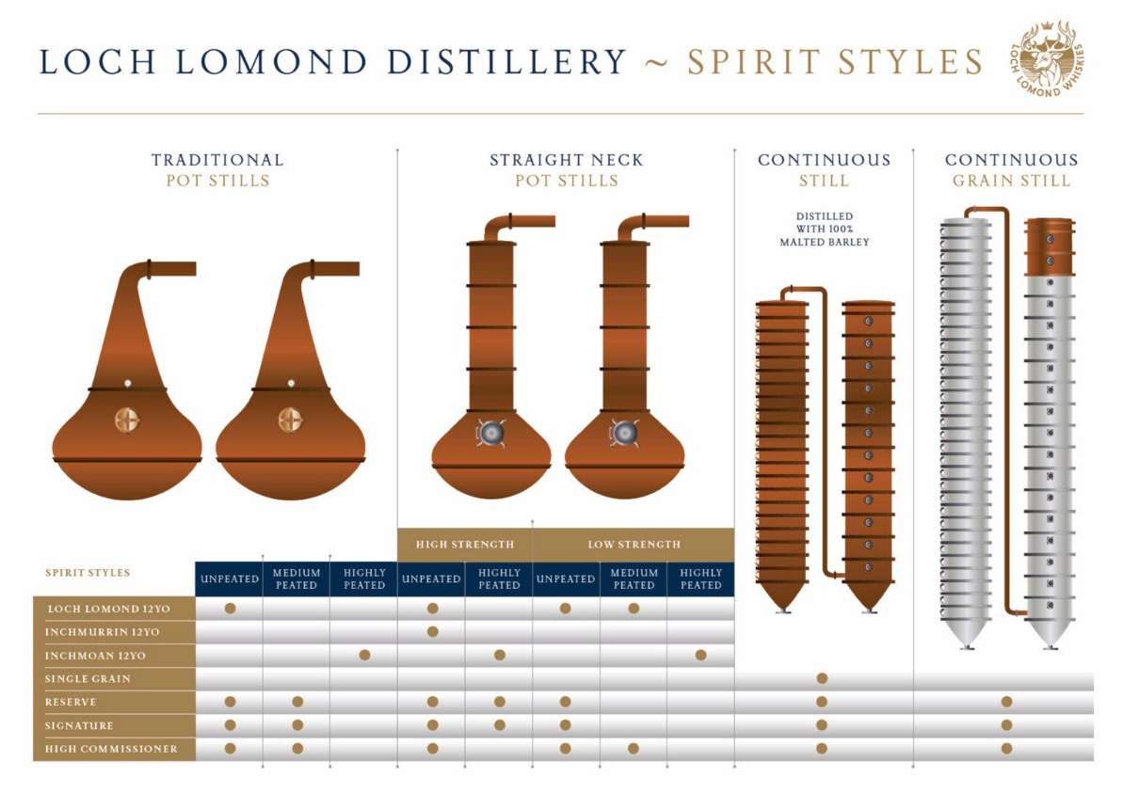
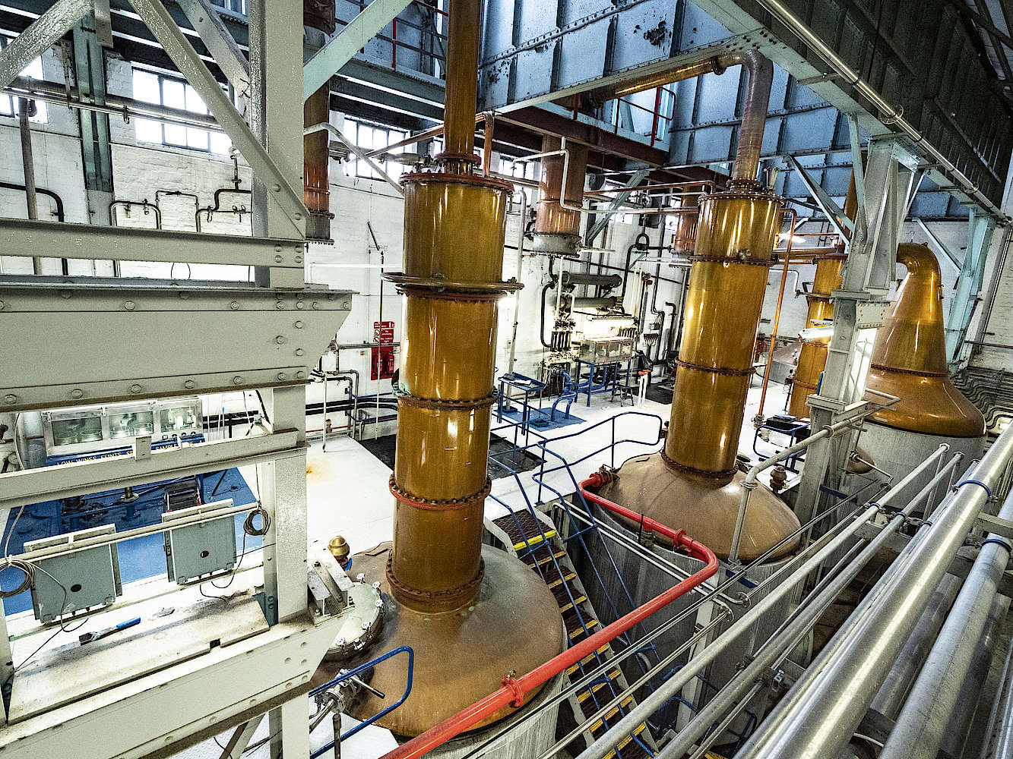
SEVENTEEN DRAMS
Loch lomond Estd. 1965
Western highlands

Slide 14

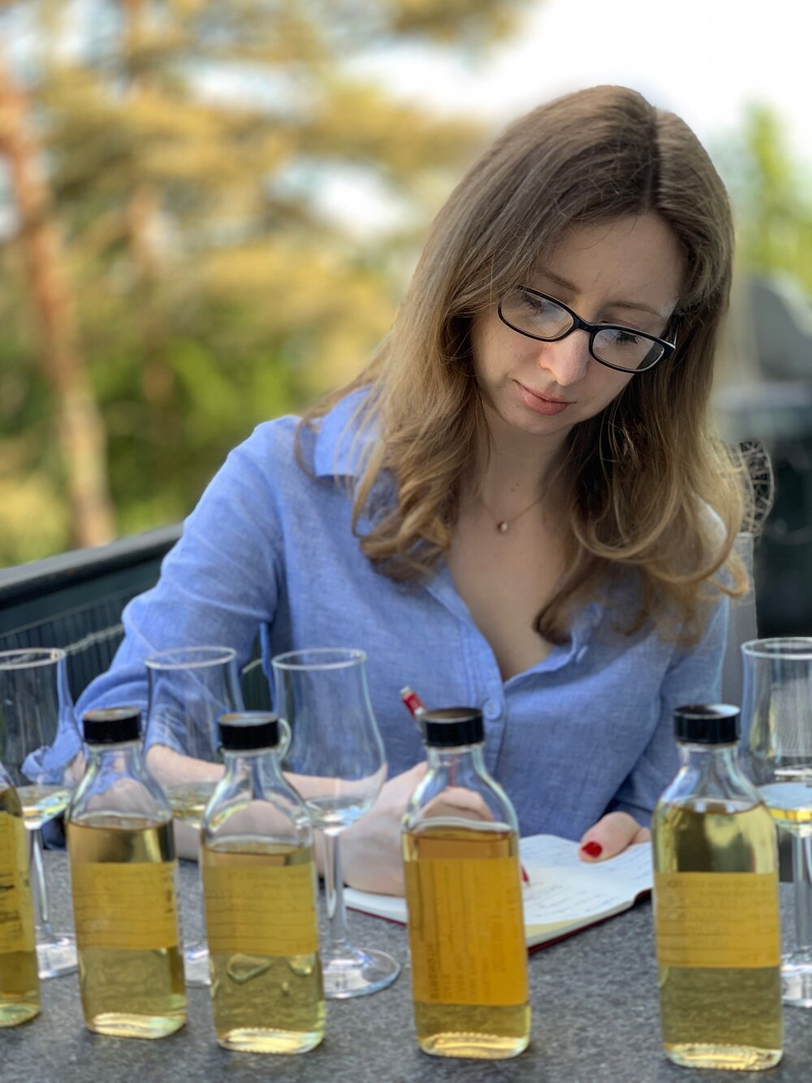

SEVENTEEN DRAMS
c. Dully selection Estd. 2019
zürich

Slide 15
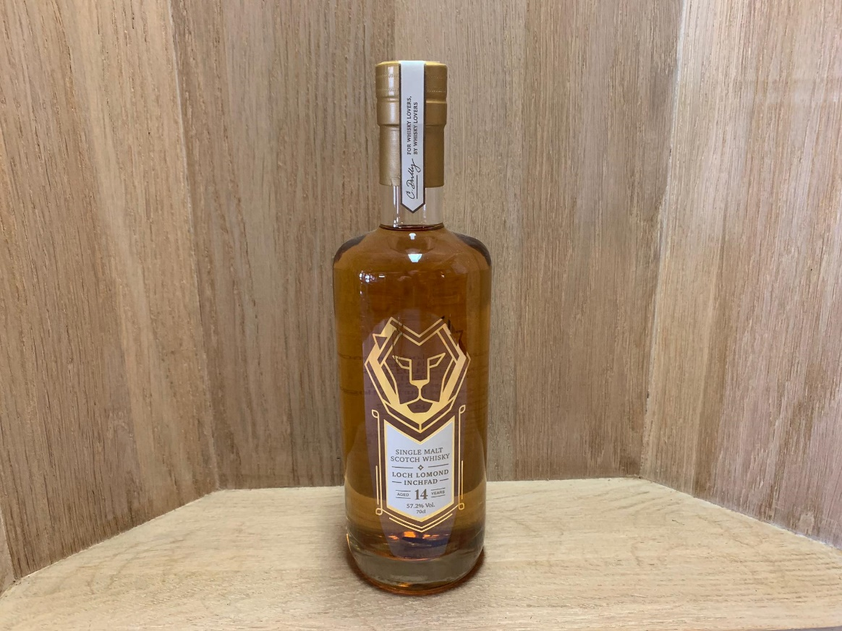
SEVENTEEN DRAMS
Loch lomond «inchfad» 14y0 2005/2019 Bourbon Hogshead Cask No. 408 57.2%

Slide 16
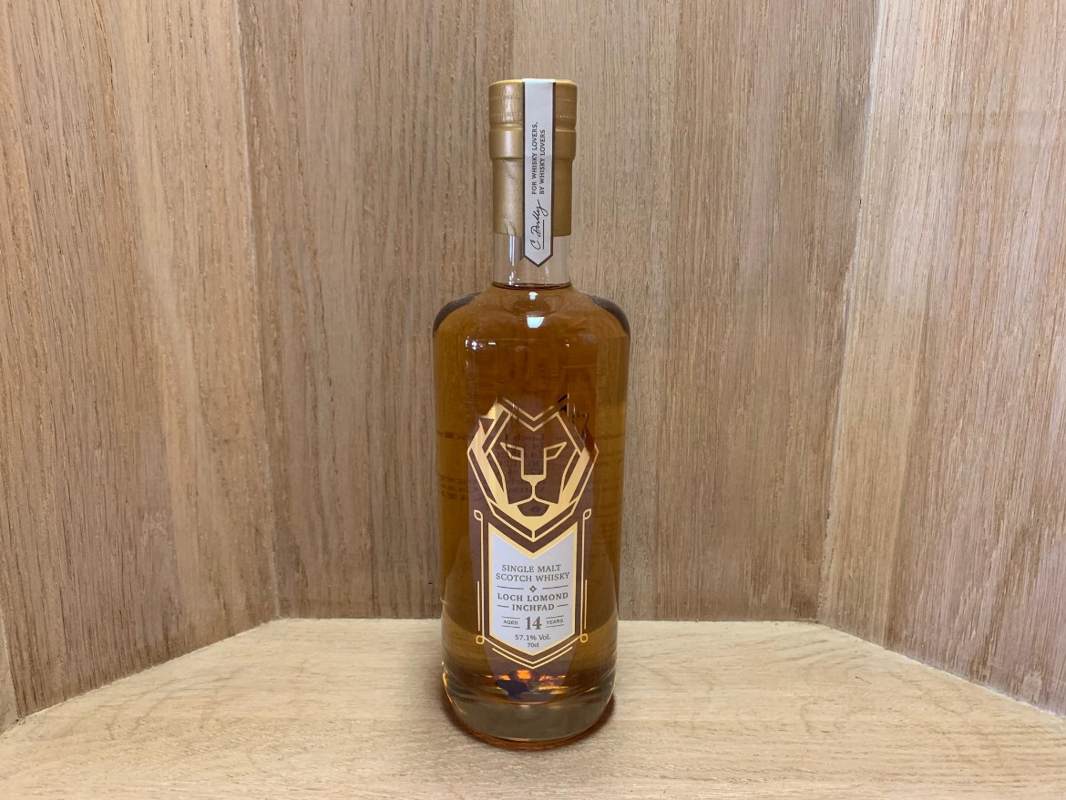
SEVENTEEN DRAMS
Loch lomond «inchfad» 14y0 2005/2019 Bourbon Hogshead Cask No. 408,411,412 57.1%

